Slide 1
NODE and MESH ANALYSIS with CONTROLLED SOURCES
The methods just described also apply, with relatively minor modifications, in the presence of dependent (controlled) sources.
Solution methods that allow for the presence of controlled sources are particularly useful in the study of transistor amplifiers…

Slide 2
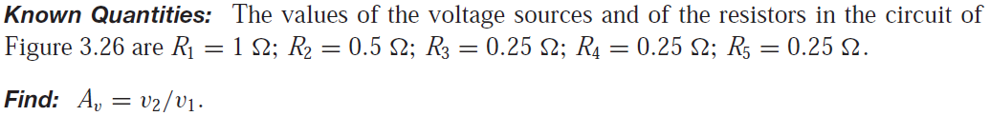
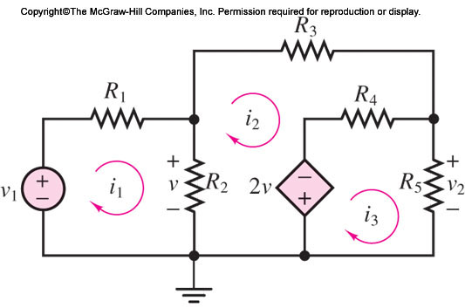
NODE and MESH ANALYSIS with CONTROLLED SOURCES
Determine the voltage “gain” Av = v2/v1 in the circuit of Figure

Slide 3
NODE and MESH ANALYSIS with CONTROLLED SOURCES
More Examples: on Whiteboard….

Slide 4
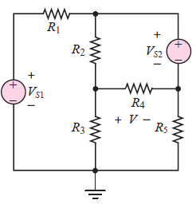
NODE and MESH ANALYSIS with CONTROLLED SOURCES
Find the node voltages in the circuit of Figure
Known Quantities: Source current; resistor values; dependent voltage source relationship.
Find: Unknown node voltage v.

Slide 5


NODE and MESH ANALYSIS with CONTROLLED SOURCES
Find the node voltages in the circuit of Figure

Slide 6
THE PRINCIPLE OF SUPERPOSITION
Analysis of linear circuits.
A precise analysis technique, such as the mesh current and node voltage methods
How we can handle multiple sources effectively?

Slide 7
THE PRINCIPLE OF SUPERPOSITION
How we can handle multiple sources effectively?
The principle of superposition is a conceptual aid that can be very useful in visualizing the behavior of a circuit containing multiple sources.

Slide 8
THE PRINCIPLE OF SUPERPOSITION
Superposition is for visualizing the behavior of a circuit containing multiple sources.
In a linear circuit containing N sources, each branch voltage and current is the sum of N voltages and currents, each of which may be computed by setting all but one source equal to zero and solving the circuit containing that single source.

Slide 9

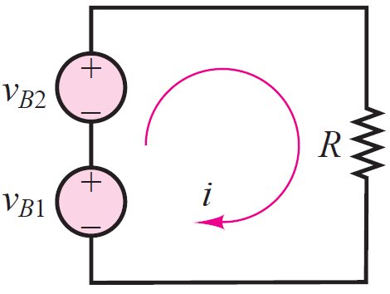
THE PRINCIPLE OF SUPERPOSITION
The circuit of Figure is more formally analyzed as follows. The current i flowing in the circuit on the left-hand side of Figure may be expressed as

Slide 10
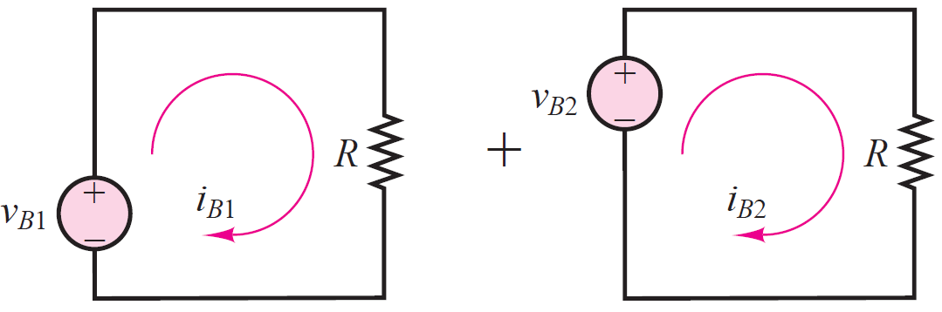
THE PRINCIPLE OF SUPERPOSITION
The circuit of Figure is more formally analyzed as follows. The current i flowing in the circuit on the left-hand side of Figure may be expressed as

Slide 11
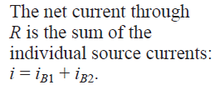
THE PRINCIPLE OF SUPERPOSITION

Slide 12
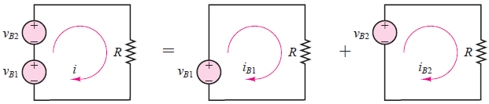
THE PRINCIPLE OF SUPERPOSITION
The figure depicts the circuit as being equivalent to the combined effects of two circuits, each containing a single source

Slide 13
THE PRINCIPLE OF SUPERPOSITION
In each of the two sub-circuits, a short circuit has been substituted for the missing battery.
This should appear as a sensible procedure, since a short circuit, by definition, will always “see” zero voltage across itself, and therefore this procedure is equivalent to “zeroing” the output of one of the
voltage sources.

Slide 14
THE PRINCIPLE OF SUPERPOSITION
For a current source, wish to cancel the effects of a current source, it would stand to reason that an open circuit could be substituted for the current source
An open circuit is, by definition, a circuit element through which no current can flow

Slide 15
THE PRINCIPLE OF SUPERPOSITION
Wish to cancel the effects of a voltage source and a current source,
A short circuit ===➔ a voltage source
An open circuit ===➔ a current source

Slide 16
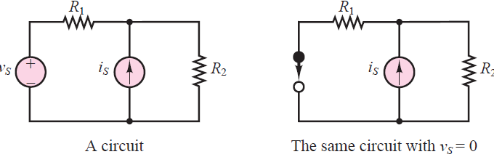
THE PRINCIPLE OF SUPERPOSITION
A short circuit ===➔ a voltage source
An open circuit ===➔ a current source
In order to set a voltage source equal to zero, we replace it with a short circuit

Slide 17
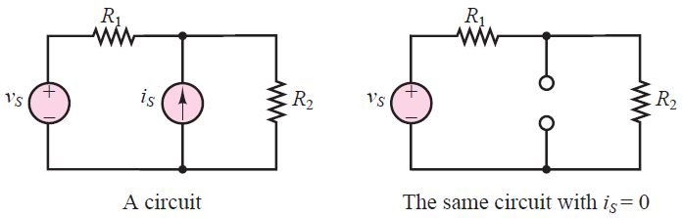
THE PRINCIPLE OF SUPERPOSITION
A short circuit ===➔ a voltage source
An open circuit ===➔ a current source
To set a current source equal to zero, replace it with an open circuit

Slide 18
THE PRINCIPLE OF SUPERPOSITION
The principle of superposition can easily be applied to circuits containing multiple sources and is sometimes an effective solution technique
To set a current source equal to zero, replace it with an open circuit

Slide 19
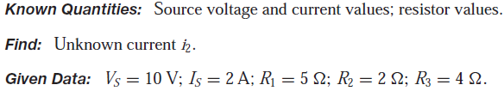
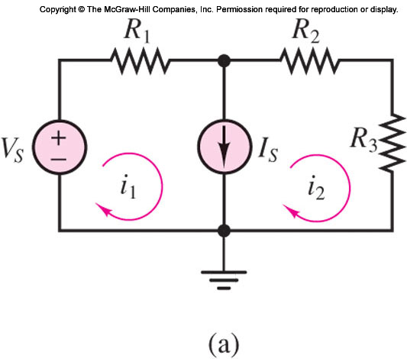
THE PRINCIPLE OF SUPERPOSITION
EXAMPLE Principle of Superposition
Problem: Determine the current i2 in the circuit of Figure, using the principle of superposition.

Slide 20
THE PRINCIPLE OF SUPERPOSITION
Determine the current i2 by principle of superposition.

Slide 21
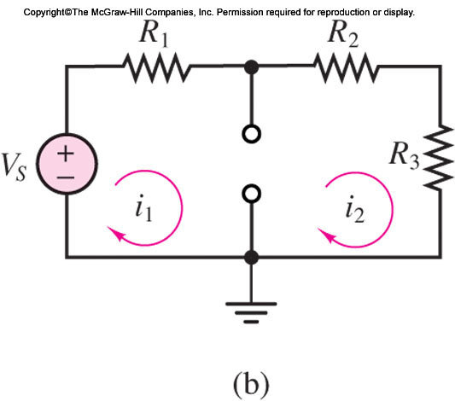
THE PRINCIPLE OF SUPERPOSITION
Determine the current i2 by principle of superposition.

Slide 22
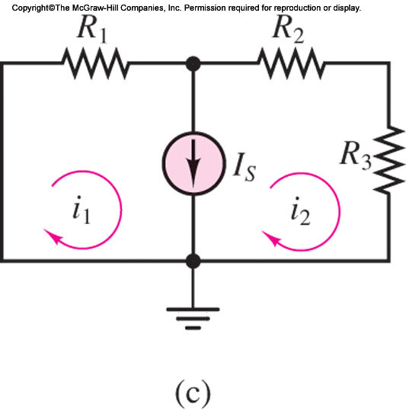
THE PRINCIPLE OF SUPERPOSITION
Determine the current i2 by principle of superposition.

Slide 23
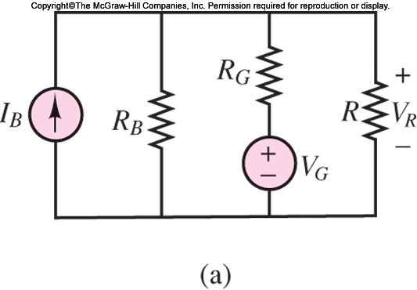
THE PRINCIPLE OF SUPERPOSITION
Determine the voltage across resistor R in the circuit by principle of superposition.

Slide 24
THE PRINCIPLE OF SUPERPOSITION
Determine the voltage across resistor R in the circuit by principle of superposition.

Slide 25

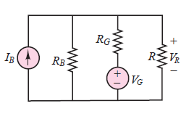
THE PRINCIPLE OF SUPERPOSITION
Determine the voltage across resistor R in the circuit by principle of superposition.

Slide 26
THE PRINCIPLE OF SUPERPOSITION
Wish to cancel the effects of a voltage source and a current source,
A short circuit ===➔ a voltage source
An open circuit ===➔ a current source

Slide 27
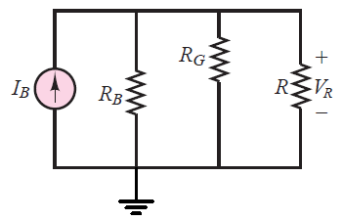
THE PRINCIPLE OF SUPERPOSITION
Determine the voltage across resistor R in the circuit by principle of superposition.

Slide 28
THE PRINCIPLE OF SUPERPOSITION
Wish to cancel the effects of a voltage source and a current source,
A short circuit ===➔ a voltage source
An open circuit ===➔ a current source

Slide 29
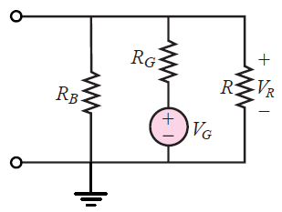
THE PRINCIPLE OF SUPERPOSITION
Determine the voltage across resistor R in the circuit by principle of superposition.

Slide 30
Thévenin and Norton Equivalent Circuits
The concept of an equivalent circuit
Possible to view even a very complicated circuit in terms of… much simpler equivalent source and load circuits…
Very complicated circuit → simpler equivalent source and load circuits,
By the transformations , reach…equivalent circuits.

Slide 31
Thévenin and Norton Equivalent Circuits
Very complicated circuit → simpler equivalent source and load circuits,.
Why?
How?

Slide 32
Thévenin and Norton Equivalent Circuits
A certain correspondence , duality,
A certain correspondence between current sources and voltage sources, on one hand, and parallel and series circuits, on the other…… What does it mean?

Slide 33
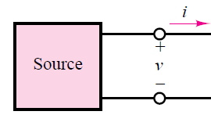
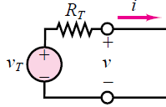
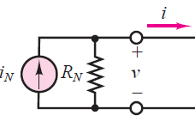
Thévenin and Norton Equivalent Circuits
A certain correspondence between current sources and voltage sources, on one hand, and parallel and series circuits, on the other…… What does it mean?
series circuits
parallel circuits

Slide 34
Thévenin and Norton Equivalent Circuits
A certain correspondence between current sources and voltage sources, on one hand, and parallel and series circuits, on the other…… What does it mean?
series circuits
parallel circuits

Slide 35
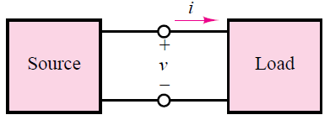
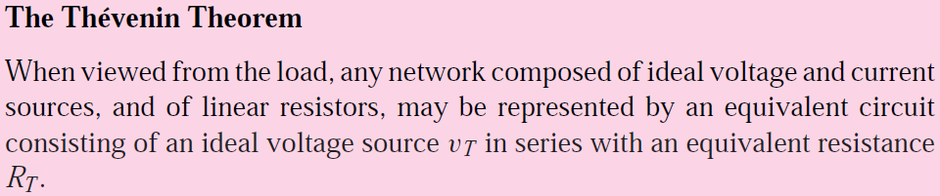
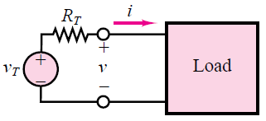
The Thévenin Theorem

Slide 36
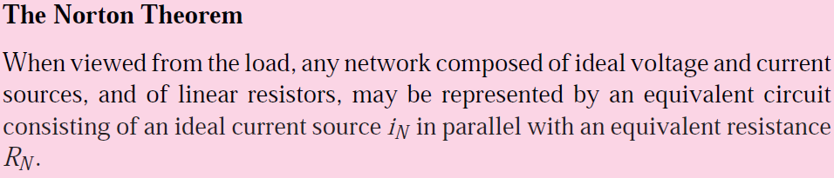
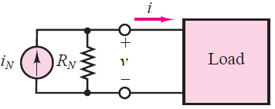
The Norton Theorem

Slide 37
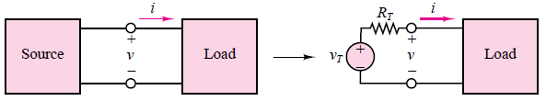
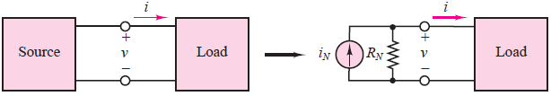
Thévenin and Norton Equivalent Circuits
series circuits - Thévenin theorem
parallel circuits - Norton theorem

Slide 38
Computing the Norton Current
series circuits - Thévenin theorem
parallel circuits - Norton theorem

Slide 39
References
Giorgio Rizzoni, “Fundamentals of Electrical Engineering”, McGraw- Hill Education, 2009. ISBN. 978-0-07-338037-7
Peyton Z. Peebles (Author), Tayeb A. Giuma, Principles of Electrical Engineering (Mcgraw Hill Series in Electrical and Computer Engineering), Mcgraw-Hill College, 1991.
Allan R. Hambley, Electrical Engineering: Principles and Applications, Prentice Hall, ISBN-0132130068, 9780132130066, 2011.

